Slide 1
Character Processing

Slide 2
Data Type: char
Type char is the character data type in C.
  One byte (eight bits) is used to store characters.
  There are 256 possible number having 8 bits, each will represent a character in a given character set.
  The ASCII character set is used in C, and most computers, to represent the mapping of 8 bit numbers to characters.
  For example, the letter ‘a’ has the ASCII code 97 which is internally represented in 8 bits as 01100001. The letter ‘0’ has the ASCII code 48 which is 00110000 in binary. The integer 0 is stored in 00000000 in binary, it will usually have either 16 or 32 bits of zeroes. Don’t confuse character numbers and ints
  This is why printf(“%d”, ‘1’) will print a 49 and printf(“%d”,’\n’) will print 10.
  The ASCII character codes are listed in an Appendix of the textbook and can be seen in most UNIX systems by entering the command:
    man ascii
  Input and Output devices have the responsibility to translate from the codes to the appropriate characters.
    For keyboards, it is easy, when you press the ‘k’ key, the value 107 is stored in memory to reflect your input.
    Output devices, such as printers and monitors, map the character codes to pixels (i.e. dots) to be placed in a display to draw the character.

Slide 3
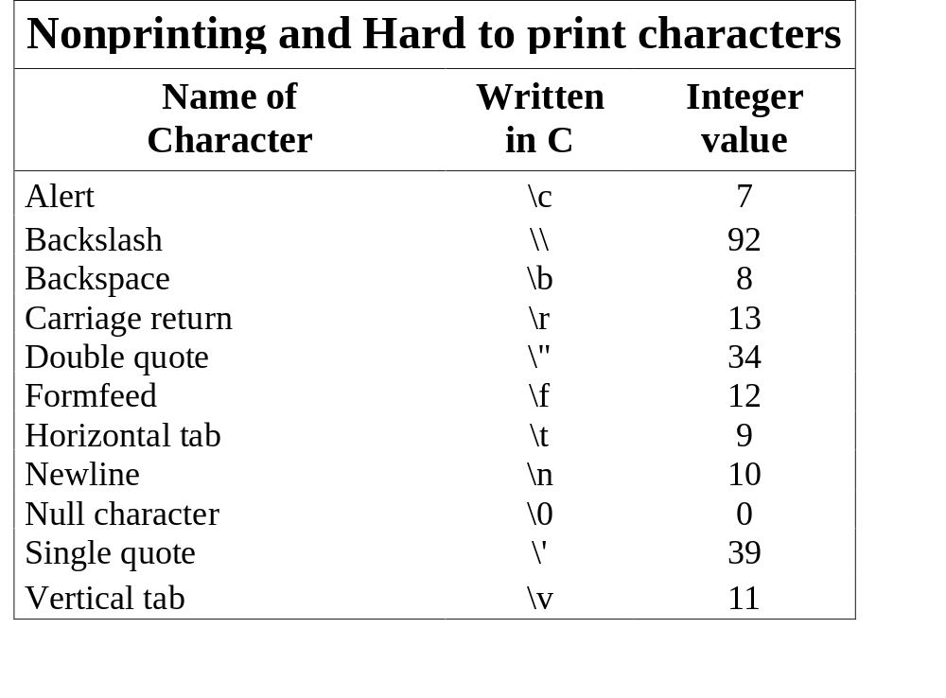
Escape Sequences

Slide 4
Outputting single characters
Rather than use printf(“%c”, mychar) which is a function call, stdio.h provides a macro to output a single character. The macro is putchar().
  A macro looks like a function, but macros are handled by the preprocessor. The C code to implement the macro is actually inserted into your program replacing the macro. Macros usually are much faster than functions but cause your program to be much larger.
  Using putchar, we would simply write:
    putchar(mychar); /* instead of printf(“%c”, mychar);
  Naturally, to output strings of characters, one should stick with the printf() function. An 8 character string would require 8 putchars, and the code would be expanded in your program 8 times.
  If you use putchar for integer data types it probably won’t do what you want, if k is of type int and has the value 97, putchar(k) will cause the character ‘a’ to be output! (Remember the ascii code for ‘a’ is 97…)

Slide 5
Getting single characters
Getchar, is the macro that returns a single character of input, like, putchar it is most appropriately used when we are getting very few characters, or are in a loop which processes one character at a time.
The dbl_out program
  #include <stdio.h>
  int main(void){
  int c;
  while ( ( c =getchar()) ! = EOF) {
  putchar ( c );
  putchar ( c );
  }
  return 0;
  }
When there is no more input, getchar returns -1, stdio.h has the line: #define EOF -1

Slide 6
The Capitalize Program
/* Capitalize lowercase letters and double space. */
#include <stdio.h>
int main(void){
  int c;
  while ( (c = getchar( ) ) != EOF )
    if (‘a’ <= c && c <= ‘z’ ) /* Assumes, upper and lowercase are */
      putchar (c + ‘A’ - ‘a’ ); /* given contiguous codes. */
    else if ( c == ‘\n’ ) {
      putchar (‘\n’);
      putchar (‘\n’);
    else
      putchar ( c );
  return 0;
}

Slide 7
Portable Caps Program
/* Capitalize lowercase letters and double space. */
#include <stdio.h>
#include <ctype.h>
int main(void){
  int c;
  while ( (c = getchar( ) ) != EOF )
    if (islower ( c ) )
      putchar (toupper ( c ) ); /* portable way to shift to upper case */
    else if ( c == ‘\n’ ) {
      putchar (‘\n’);
      putchar (‘\n’);
    else
      putchar ( c );
  return 0;
}

Slide 8
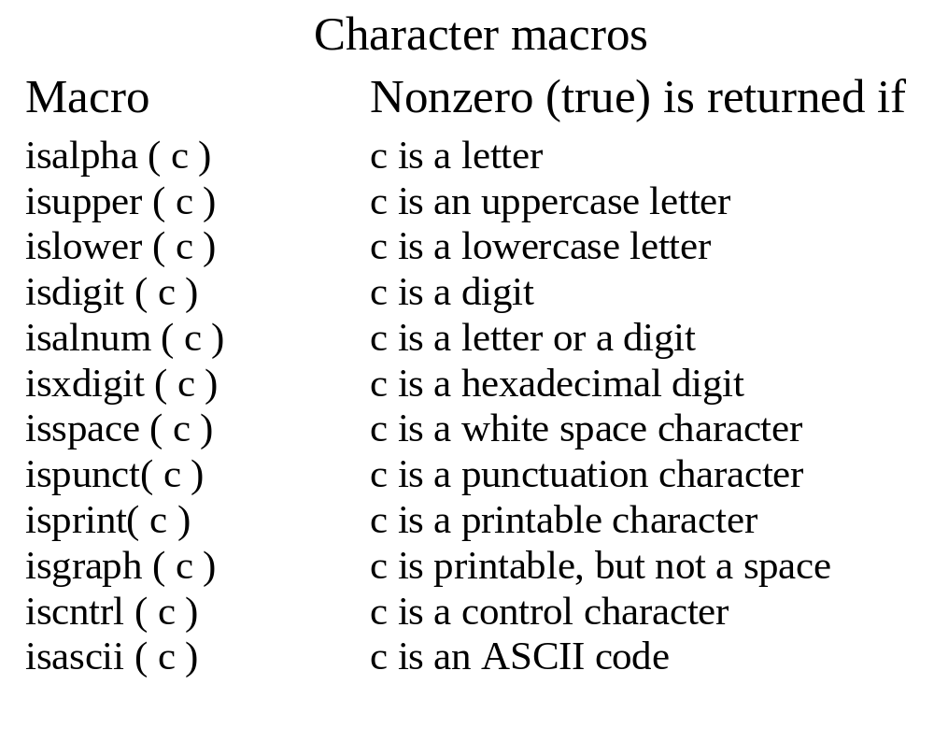
Character Macros from ctype.h

Slide 9
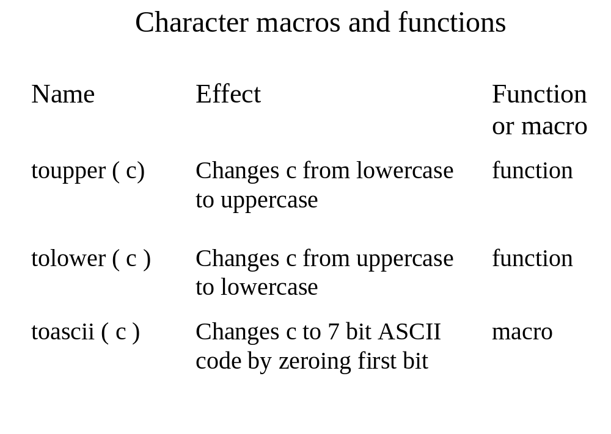
Notes:
Repeating Characters

Slide 10
Example: Repeating Character Function
#include <stdio.h>
#include <ctype.h>
void repeat ( char c, int how_many ){
  int i;
  for ( i= 0; i < how_many; ++ i)
  putchar( c );
}
int main (void){
  int i;
  const char alert = ‘\a’, c = ‘A’;
  repeat (‘B’ - 1, 2);
  putchar (‘ ‘);
  for (i = 0; i < 10; ++i ){
  repeat (c+i , i);
  putchar (‘ ‘);
  }
  repeat (alert, 100);
  putchar (‘\n’);
  return 0;
}

Slide 11
Counting Words
The problem: Count the number of words being input. Words are defined as those non-white space characters that are separated by white space. Processing should count words until the end of file condition is raised.
Idea: Loop finding whitespace then loop finding non-white space until end of file:

Slide 12
Counting Words Illustration
Here is some spaced out text
Start Here looping on non-white space
Here is some spaced out text
End Here looping on non-white space, increment counter
Start Here looping on white space
Here is some spaced out text
End Here looping on white space
Start Here looping on non-white space

Slide 13
Pseudocode for word_count main
Pseudocode for main
  Initialize:
    word_count = 0 word_found = true
  Process:
    while (word_found)
    word_found = find_next_word
    if word_found
    word_count = word_count + 1
    endwhile

Slide 14
Pseudocode for find_next_word
  -Process:
  read an input character into c
  if end_of_file encountered
  return 0
  else
  while c is a whitespace character and end_of_file not encountered
  read an input character into c
  if end_of_file encountered
  return 1
  while c is not a white space character and end_of_file not encountered
  read an input character into c
  return 1

Slide 15
Program for word_count
#include <stdio.h>
#include <ctype.h>
int found_next_word( void );
int main (void ){
int word_count = 0;
while ( found_next_word () == 1)
++ word_count;
printf(“Number of words = %d\n\n”, word_count);
return 0;
}
int found_next_word(void){
int c;
while ( isspace ( c = getchar( ) ); /* skip white space, empty statement */
if ( c != EOF){
while ( ( c = getchar ( ) ) != EOF && ! isspace ( c ) ); /* skip non-white space */
return 1;
}
return 0;
}

Slide 16
Common Programming Errors
Printing int or float data using putchar(). Remember, it does not covert to printable characters. The following code prints out the letter ‘z’.
  int i=122;
  putchar(i);
Using getchar to get a character into a char identifier and testing the char for EOF. It is safe to use char only if not testing for end of file.
Using getchar() to read numbers
  int i;
  i = getchar();
  putchar(++i);
  Given 87 as input, this code prints out ‘9’.
Passing an argument (or an &) to getchar().

